Slide 1
High Frequency Trading
May 31, 2016

Slide 2
What is High Frequency Trading? (HFT)
High Frequency trading is an automated trading platform used by large investment banks, hedge funds and institutional investors which utilizes powerful computers to transact a large number of order at an extremely high speed.

Slide 3
Ways HFT’s make money
Arbitrage
If 2 stocks are correlated (could be the same stock on 2 different exchanges), and if the price of 1 stock increases minutely, then these algorithms will immediately purchase the correlated stock, and then sell in microseconds later when the price increases.
Spoofing
This consists of entering a large number of orders on one/both sides of the order book to give the impression of liquidity and to trigger other algorithms while ultimately wanting to trade on the other side.

Slide 4
Ways HFT Make Money (cont’d)
More Arbitrage:
If an investor tries to buy the same stock across multiple exchanges, the HFTers, will buy the stocks he wanted on the all non-home exchanges as soon as they see his bid on the first exchange, and try and sell it to him for more.
Automated Liquid Provision
Also known as market making, this is a strategy that involves optimal placing and pricing of limit orders.
Pinging
This involves entering an order then immediately cancelling it to discover hidden liquidity

Slide 5
Assets suitable for HFT
High liquidity to be able to quickly move in and out of positions
Sufficient volatility so that price movement exceeds transactions costs.
Level of predictability in asset’s price range.

Slide 6
Characteristics of HFTers: Measures
Aggressive trade: initiate the trade, much more than passive trade
Measure of massive order flow and short order lifetime
Measure if a participant inserts updates or cancels a “large” amount of “orders” during a “short” period of time.
Take the median of the market participants central order lifetime.
Short position holdings
No overnight position
Could look for market participants with short position holding times with little or no overnight position.

Slide 7
Self-Trades: A possible finger print
Why would an HFT self trade?
As part of spoofing, HFT’s like to give the impression of liquidity to try and get other algorithmic traders to jump in. If these HFT’s trick the other algorithms into buying up stocks, then they stand to profit.
Self trades are a way to give the impression of liquidity.

Slide 8
Plot: Total trades vs. Self Trades

Slide 9
Low-latency trading Journal of Financial Markets (2013)
Cited by 400 (scholar.google.ca)
Among the 1% most cited (according to Essential Science Indicators).
Joel Hasbrouck (Stern SchoolofBusiness)
GideonSaarb (School of Management, Cornell University)

Slide 10
High-Frequency Trading
Types of HFT:
Agency algorithms: provide liquidity to big volume orders.
Based on historical estimates of price impact and execution probability across multiple trading venues
Proprietary algorithms.
Goal: profit
More diverse and more difficult to concisely characterize.

Slide 11
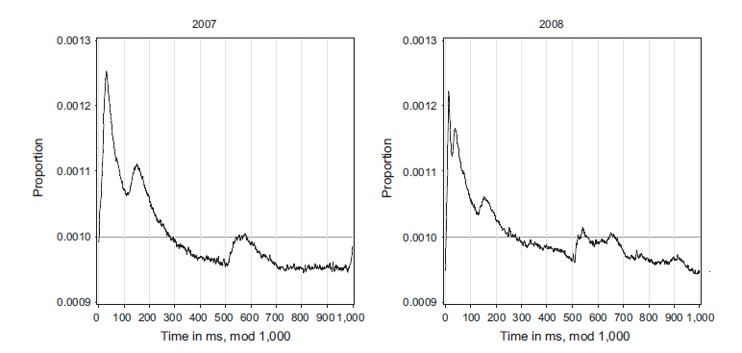
Distribution of Arrival Messages to Market
1 sec
Inside each second
Expected:
uniformly distributed

Slide 12
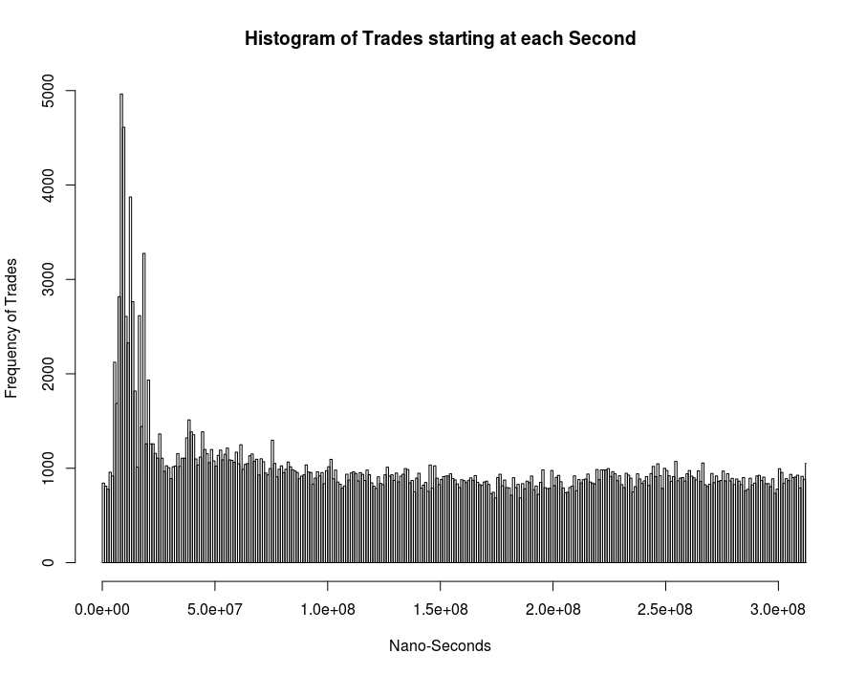
TMX Distribuition (inside each second)

Slide 13
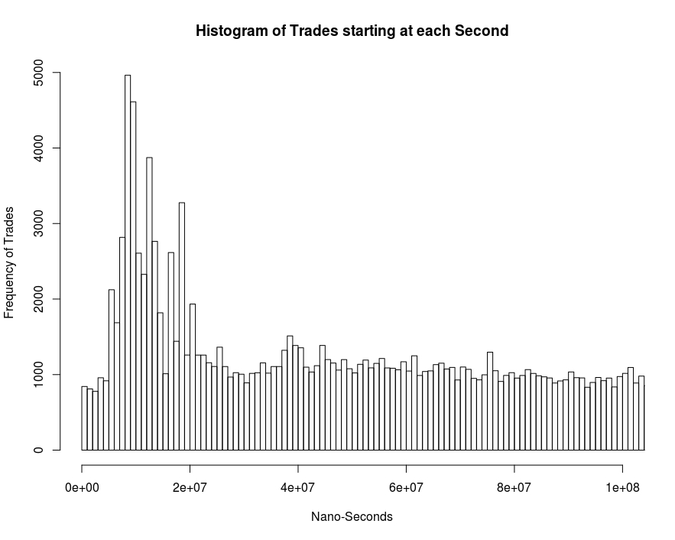
TMX Distribuition (inside each second)

Slide 14
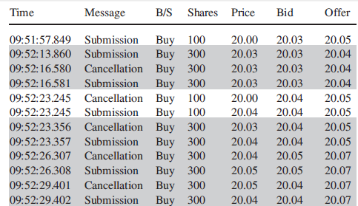
Figure from Hasbrouck et al.
Obs: No Broker Info
TMX didn’t sent us those info.

Slide 15
Number of Trades for Broker (TMX file)
Case Study : December 4th 015
There are 70 active brokers.
Most Active Brokers
Least Active Brokers
All Stocks
TD
Broker ID | Nb. of Trades
1 | 426,389
79 | 405,533
7 | 126,151
2 | 106,363
53 | 106,188
Broker ID | Nb. of Trades / TD
1 | 6,932
79 | 6,704
7 | 2,881
9 | 2,624
2 | 1,535
Broker ID | Nb. of Trades
92 | 22
71 | 22
55 | 12
86 | 12
150 | 4

Slide 16
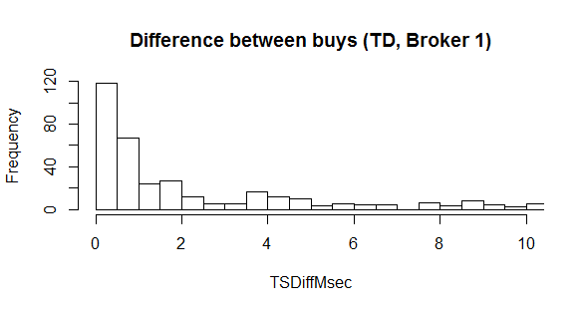
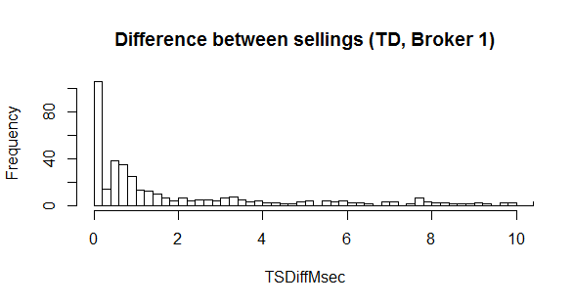
Stock: TD – Broker 1 (TMX file)
1716 buys / day
1900 sellings / day
Dec 3rd 2015

Slide 17
Quality Market
Quality Market:
Spread: time-wieghted avg quoted spread;
Effective Spread: avg spread (quote midpoint) for marketable orders;
Near Depth: time-wieghted avg nb of shares in the book;
High Low: highest midquote – lowest midquote (%).

Slide 18
High-Frequency Trading
Questions to be investigated:
effects of HFT on Market Quality :
spreads and short-term volatility declines during normal market conditions.
opposite effect during times of extremely high market volatility

Slide 19
High-Frequency Trading
Questions to be investigated:
HFT’s strategies
Are HFT’s profitable?
Effetcs of HFT’s restriction:
Volatility
Stocks Exchanges
Effect of Structural Delays in Order Processing;

Slide 20
High-Frequency Trading (regulation)
National Instrument 23-103 (Canada)
Electronic Trading and Direct Electronic Access to Marketplaces:
The legislation requires users of automated order systems to ensure that their use of the systems “does not interfere with fair and orderly markets,” to test their systems at least annually, to acquire sufficient knowledge of their systems to “identify and manage the risks associated with the use of [the systems],” and to be able to immediately halt their systems if necessary.

Slide 21
High-Frequency Trading
Proposal
Analysis
Initial
Analysis
TMX presentation
No Enouth Data
no priority
Wait for New Data
Waiting...

